Slide 1
Exploratory Data Analysis and Data Visualization
‹#›
Assignment: Read Chapter 2 in Doing Data Science
-> Read the code examples discussed in the book
Notes:
‹#›

Slide 2
Outline
‹#›
Data Science Cycle
EDA

Slide 3
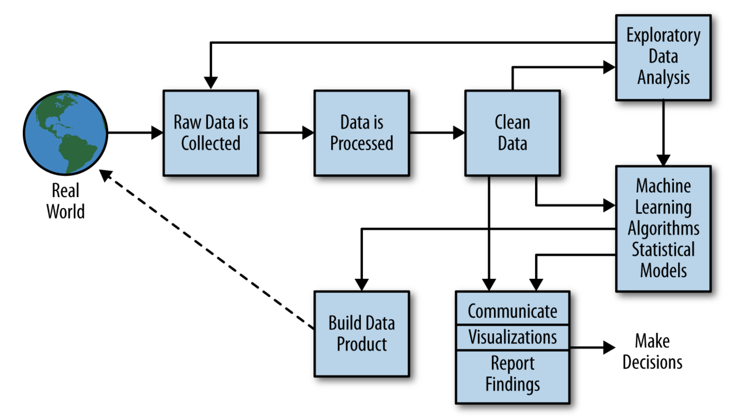
Data Science Cycle
‹#›
Figure from book

Slide 4
EDA and Visualization
‹#›
Exploratory Data Analysis (EDA) and Visualization are very important steps in any analysis task.
get to know your data!
distributions (symmetric, normal, skewed)
data quality problems
outliers
correlations and inter-relationships
subsets of interest
suggest functional relationships
Sometimes EDA or viz might be the goal!
Notes:
‹#›

Slide 5
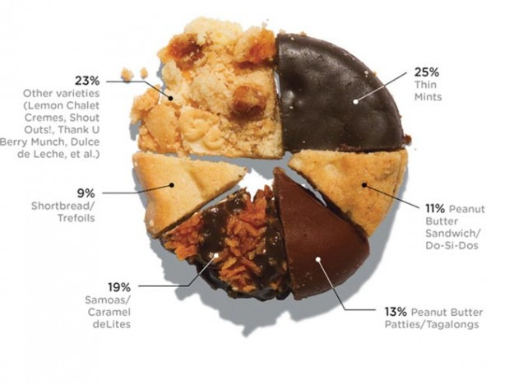
Data Visualization – cake bakery
‹#›
Notes:
‹#›

Slide 6
Exploratory Data Analysis (EDA)
‹#›
Goal: get a general sense of the data
means, medians, quantiles, histograms, boxplots
You should always look at every variable - you will learn something!
Think interactive and visual
Humans are the best pattern recognizers
You can use more than 2 dimensions!
x,y,z, space, color, time….
Especially useful in early stages of data mining
detect outliers (e.g. assess data quality)
test assumptions (e.g. normal distributions or skewed?)
identify useful raw data & transforms (e.g. log(x))
Bottom line: it is always well worth looking at your data!

Slide 7
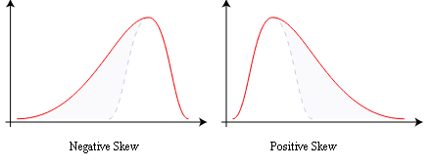
Summary Statistics
‹#›
not visual
sample statistics of data X
mean: μ = ∑_{i} X_{i} / n
mode: most common value in X
median: X=sort(X), median = X_{n/2} (half below, half above)
quartiles of sorted X: Q1 value = X_{0.25n} , Q3 value = X_{0.75 n}
interquartile range: value(Q3) - value(Q1)
range: max(X) - min(X) = X_{n} - X₁
variance: σ² = ∑_{i} (X_{i} - μ)² / n
skewness: ∑_{i} (X_{i} - μ)³ / [ (∑_{i} (X_{i} - μ)²)^{3/2} ]
zero if symmetric; right-skewed more common (what kind of data is right skewed?)
number of distinct values for a variable (see unique() in R)
Don’t need to report all of thses: Bottom line…do these numbers make sense???

Slide 8
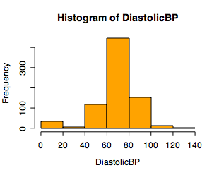
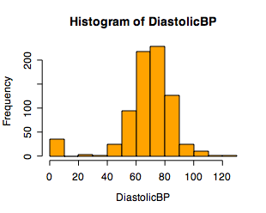
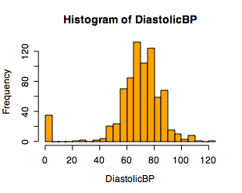
Single Variable Visualization
‹#›
Histogram:
Shows center, variability, skewness, modality,
outliers, or strange patterns.
Bin width and position matter
Beware of real zeros

Slide 9
Issues with Histograms
‹#›
For small data sets, histograms can be misleading.
Small changes in the data, bins, or anchor can deceive
For large data sets, histograms can be quite effective at illustrating general properties of the distribution.
Histograms effectively only work with 1 variable at a time
But ‘small multiples’ can be effective

Slide 10
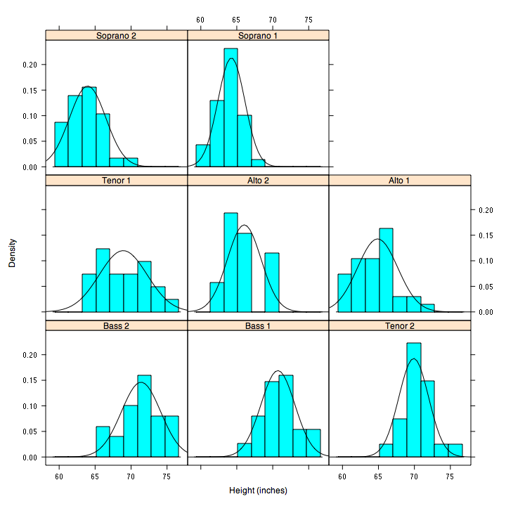
‹#›
But be careful with axes and scales!

Slide 11
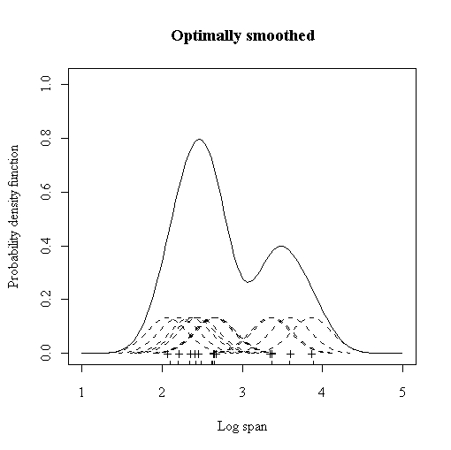
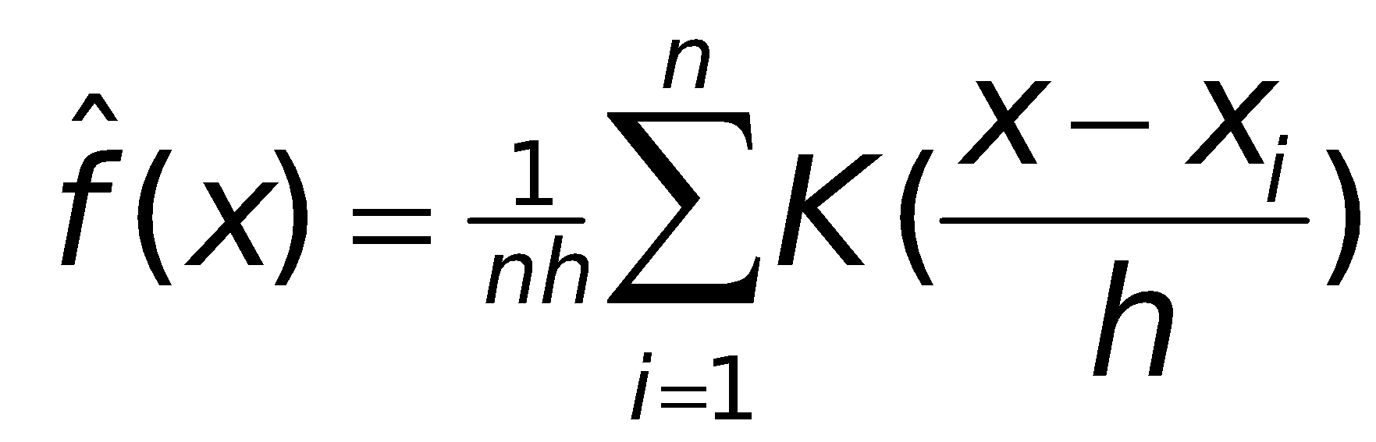
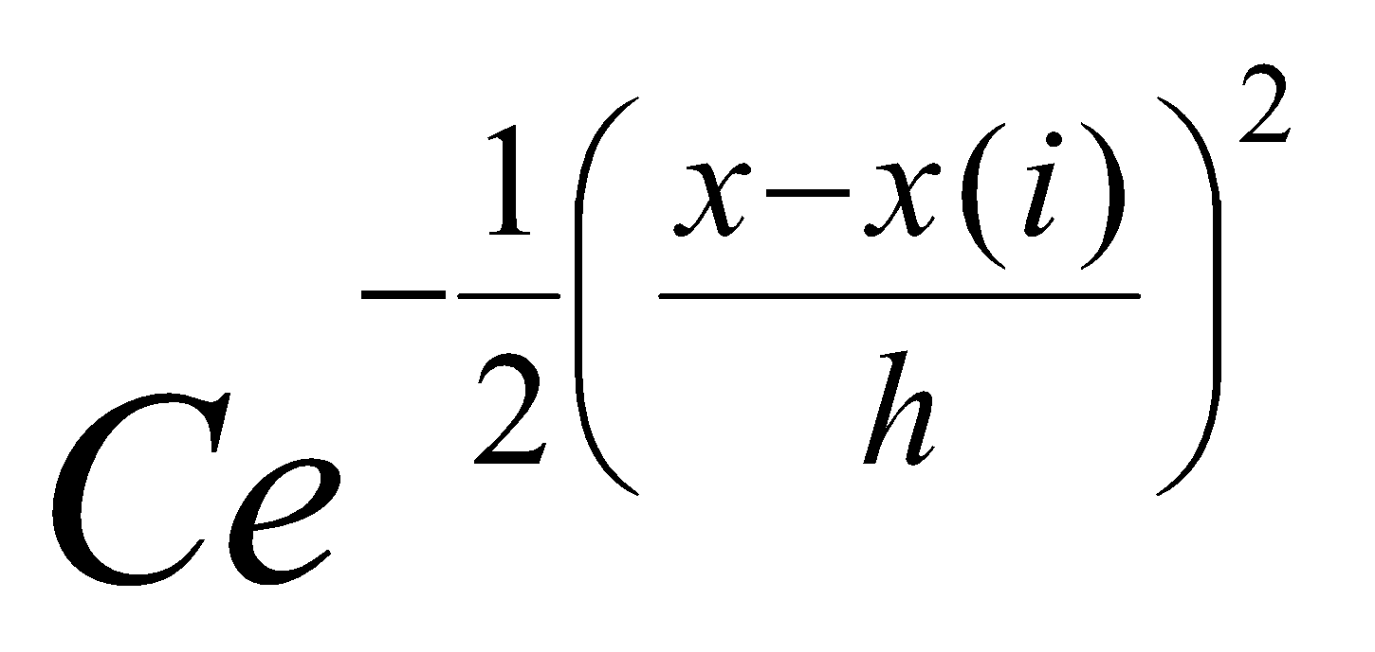
Smoothed Histograms - Density Estimates
‹#›
Kernel estimates smooth out the contribution of each datapoint over a local neighborhood of that point.
h is the kernel width
Gaussian kernel is common:

Slide 12
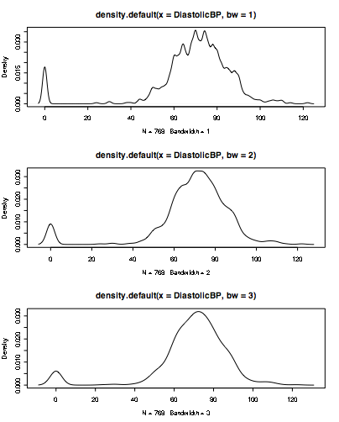
‹#›
Bandwidth choice is an art
Usually want to try several

Slide 13
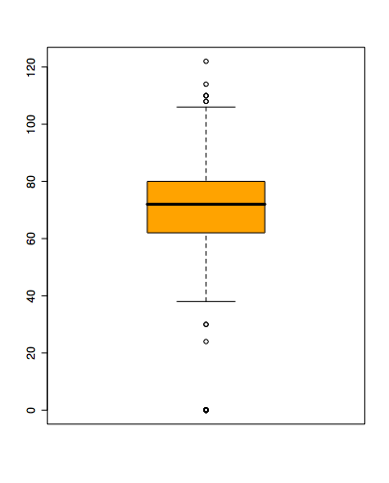
Boxplots
‹#›
Shows a lot of information about a variable in one plot
Median
IQR
Outliers
Range
Skewness
Negatives
Overplotting
Hard to tell distributional shape
no standard implementation in software (many options for whiskers, outliers)

Slide 14
Time Series
‹#›
If your data has a temporal component, be sure to exploit it
summer bifurcations in air travel
(favor early/late)
summer
peaks
steady growth
trend
New Year bumps

Slide 15
Time-Series Example 3
mean weight vs mean age
for 10k control group
Scotland experiment:
“↑ milk in kid diet → better health” ?
20,000 kids:
5k raw, 5k pasteurize,
10k control (no supplement)
Possible explanations:
Grow less early in year than later?
No steps in height plots; so why
height ↑ uniformly, weight ↑ spurts?
Kids weighed in clothes: summer garb lighter than winter?
Would expect smooth weight growth plot.
Visually reveals
unexpected pattern (steps),
not apparent from raw data table.

Slide 16
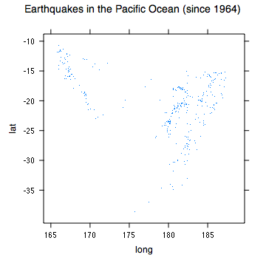
Spatial Data
‹#›
If your data has a geographic component, be sure to exploit it
Data from cities/states/zip cods – easy to get lat/long
Can plot as scatterplot

Slide 17
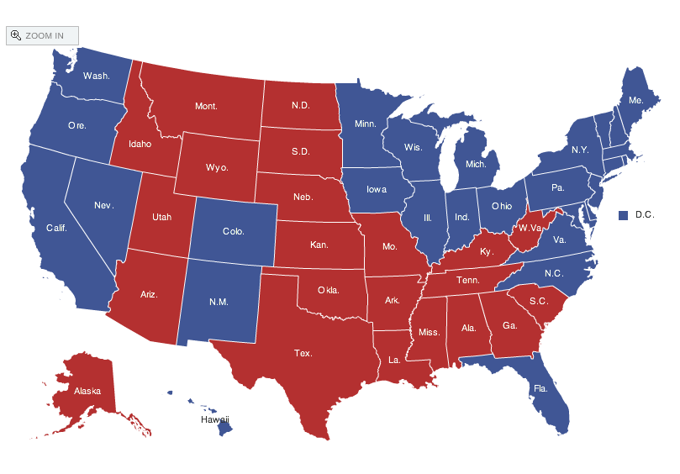
Spatial data: choropleth Maps
‹#›
Maps using color shadings to represent numerical values are called chloropleth maps
http://elections.nytimes.com/2008/results/president/map.html

Slide 18
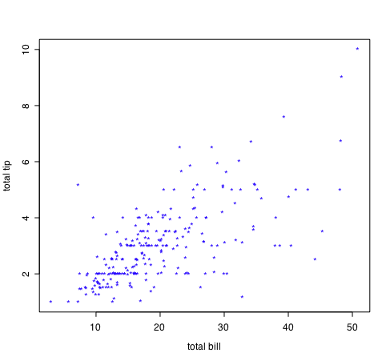
Two Continuous Variables
‹#›
For two numeric variables, the scatterplot is the obvious choice
interesting?
interesting?

Slide 19
2D Scatterplots
‹#›
useful to answer:
x,y related?
linear
quadratic
other
variance(y) depend on x?
outliers present?
standard tool to display relation between 2 variables
e.g. y-axis = response, x-axis = suspected indicator
interesting?
interesting?

Slide 20
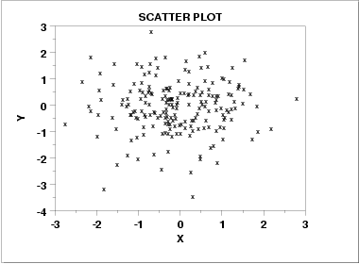
Scatter Plot: No apparent relationship
‹#›

Slide 21
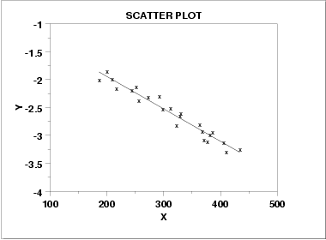
Scatter Plot: Linear relationship
‹#›
Notes:
Horizontal line in box is median (Q2)
Top and bottom of plot are always Q1 and Q3
Whiskers can mean several things: usually these are the minimum and maximum of all of the data
Values outside this range are pkptted as outliers (circles)
‹#›

Slide 22
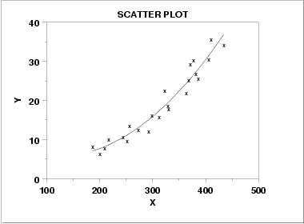
Scatter Plot: Quadratic relationship
‹#›

Slide 23
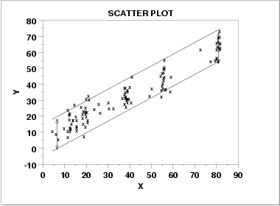
Scatter plot: Homoscedastic
‹#›
Why is this important in classical statistical modelling?

Slide 24
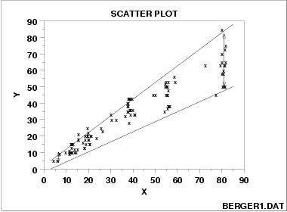
Scatter plot: Heteroscedastic
‹#›
variation in Y differs depending on the value of X
e.g., Y = annual tax paid, X = income

Slide 25
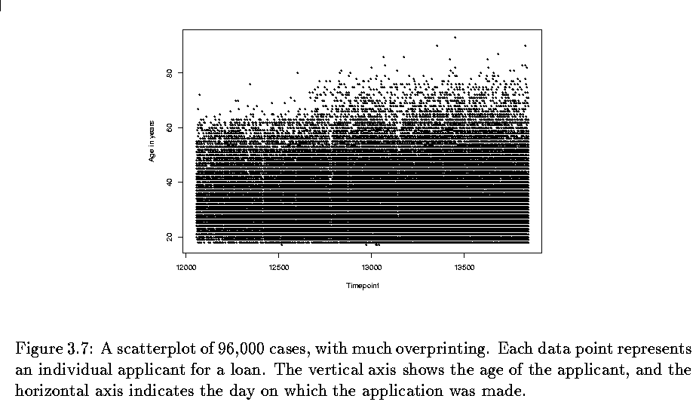
Two variables - continuous
‹#›
Scatterplots
But can be bad with lots of data

Slide 26
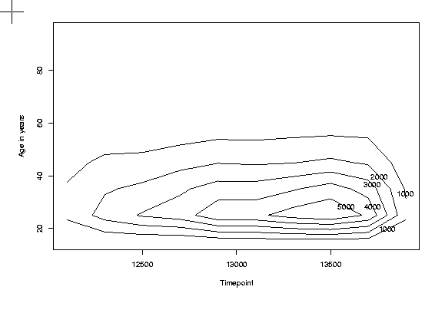
Two variables - continuous
‹#›
What to do for large data sets
Contour plots

Slide 27
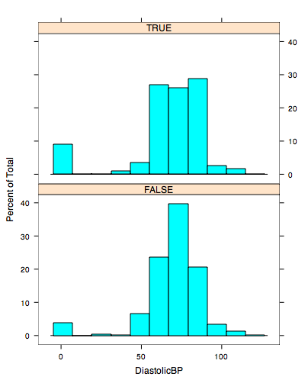
Displaying Two Variables
‹#›
If one variable is categorical, use small multiples
Many software packages have this implemented as ‘lattice’ or ‘trellis’ packages
library(‘lattice’)
histogram(~DiastolicBP | TimesPregnant==0)

Slide 28
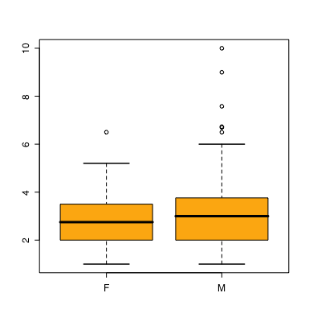
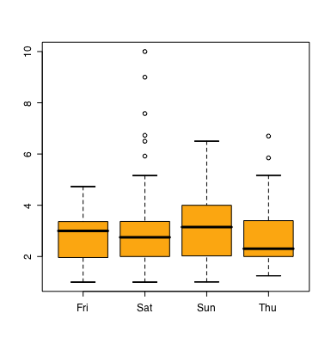
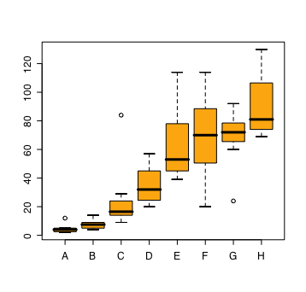
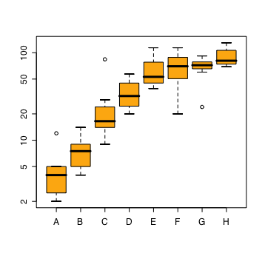
Two Variables - one categorical
‹#›
Side by side boxplots are very effective in showing differences in a quantitative variable across factor levels
tips data
do men or women tip better
orchard sprays
measuring potency of various orchard sprays in repelling honeybees

Slide 29
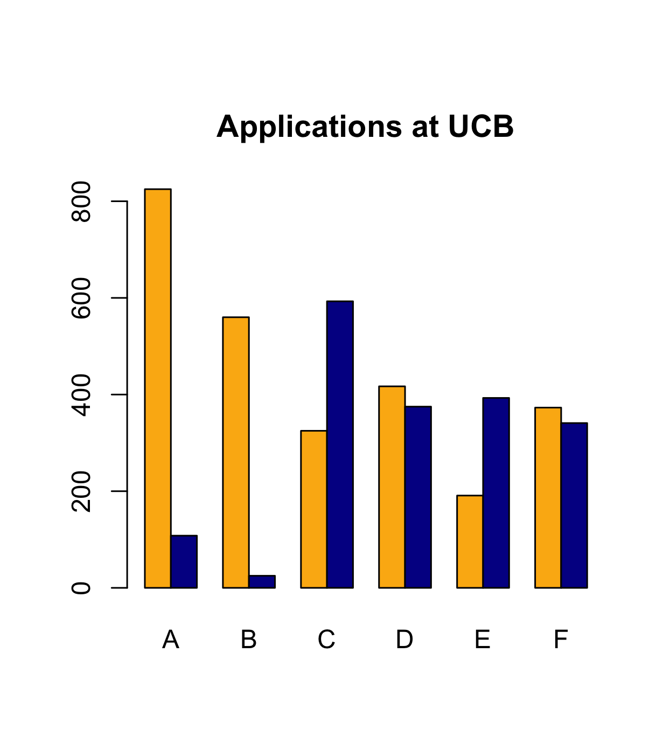
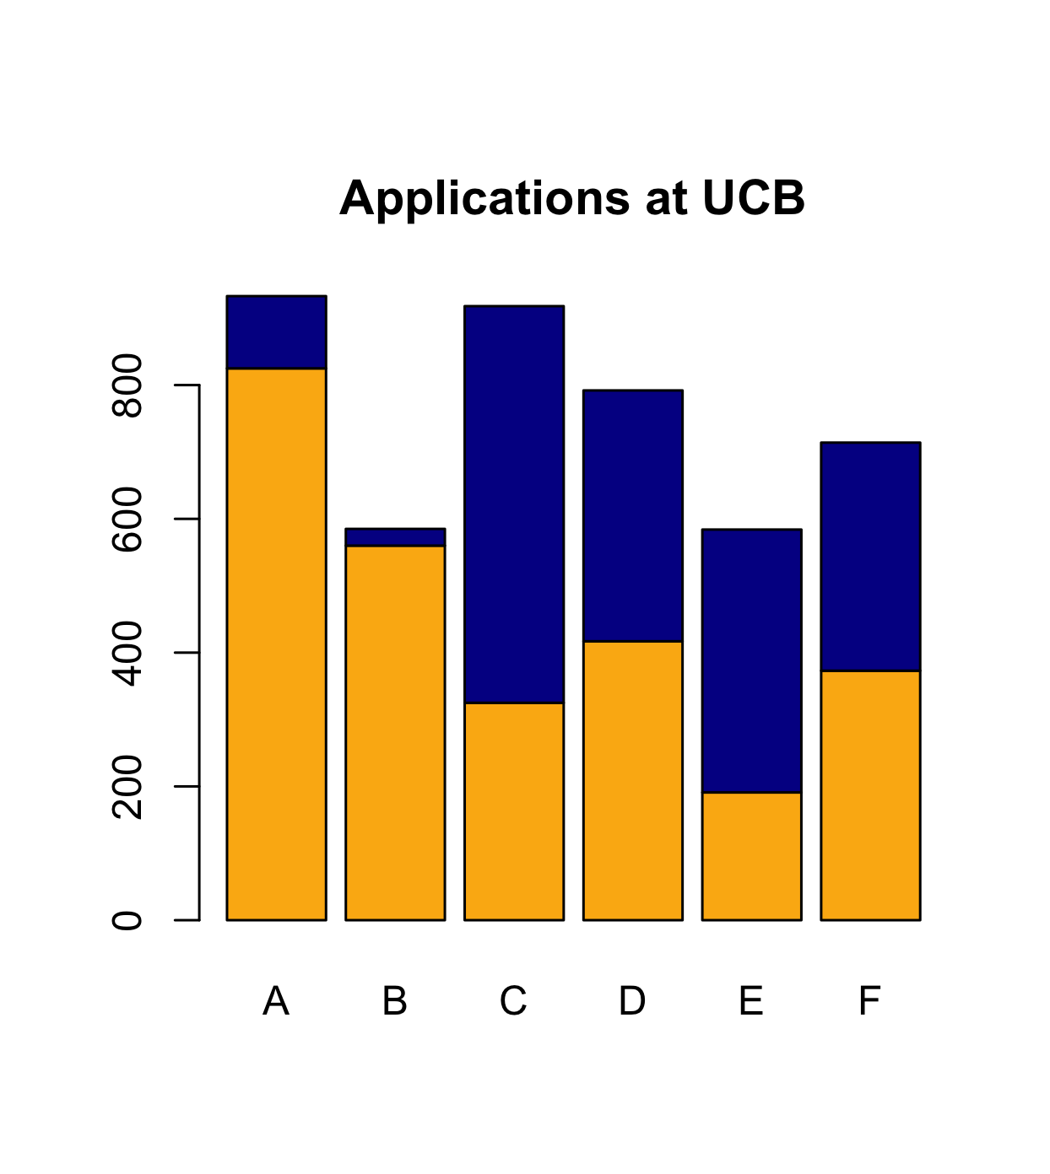
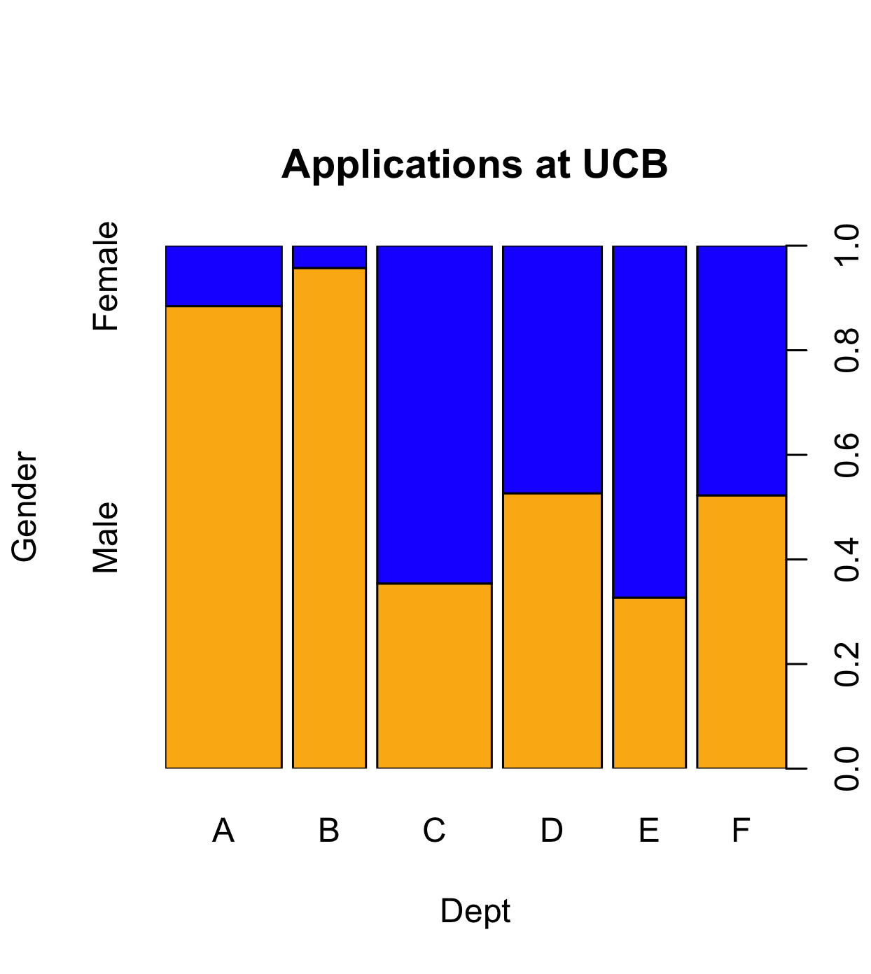
Barcharts and Spineplots
‹#›
stacked barcharts can be used to compare continuous values across two or more categorical ones.
spineplots show proportions well, but can be hard to interpret
orange=M blue=F

Slide 30
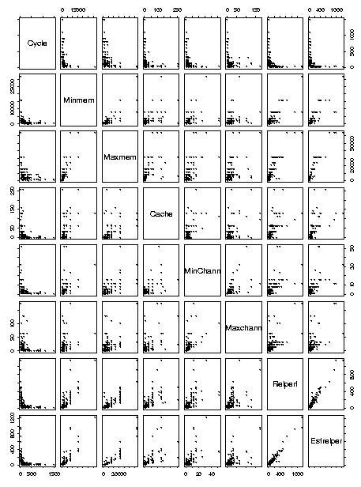
More than two variables
‹#›
Pairwise scatterplots
Can be somewhat ineffective for categorical data

Slide 31
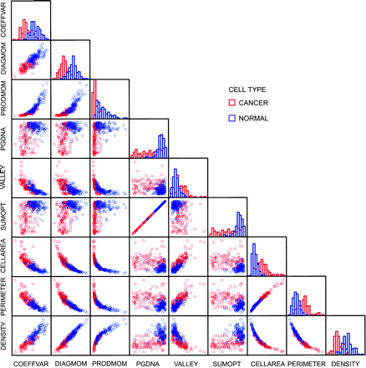
‹#›

Slide 32
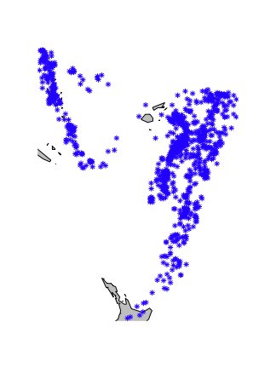
Multivariate: More than two variables
‹#›
Get creative!
Conditioning on variables
trellis or lattice plots
Cleveland models on human perception, all based on conditioning
Infinite possibilities
Earthquake data:
locations of 1000 seismic events of MB > 4.0. The events occurred in a cube near Fiji since 1964
Data collected on the severity of the earthquake

Slide 33
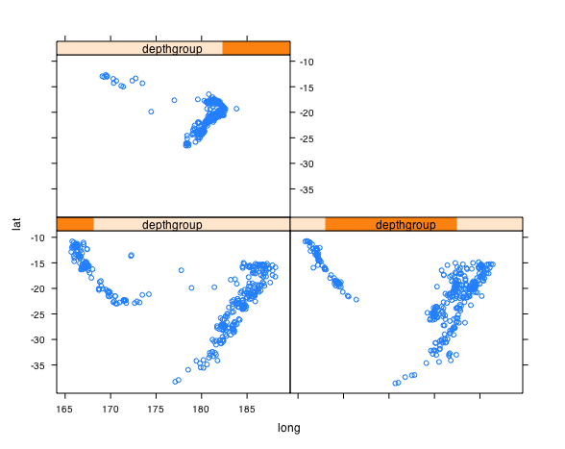
‹#›

Slide 34
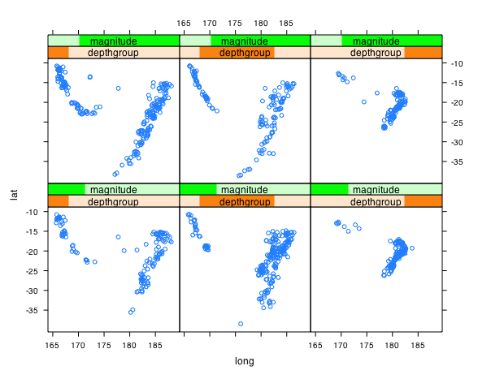
‹#›

Slide 35
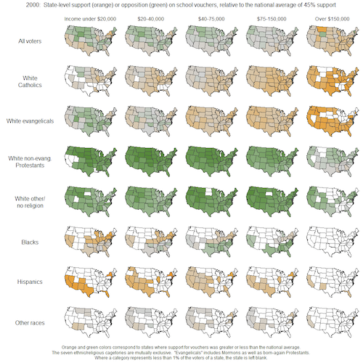
‹#›
How many dimensions are represented here?
Andrew Gelman blog 7/15/2009

Slide 36

Multivariate Vis: Parallel Coordinates
Petal, a non-reproductive part of the flower
Sepal, a non-reproductive part of the flower
The famous iris data!
‹#›

Slide 37
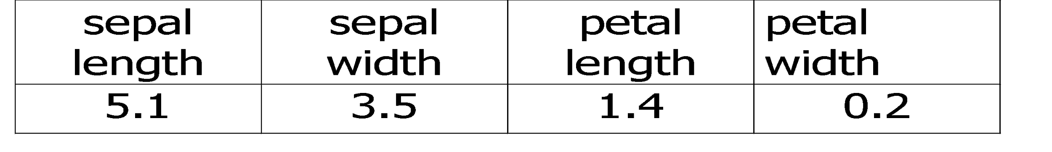
Parallel Coordinates
Sepal
Length
5.1
‹#›

Slide 38
Parallel Coordinates: 2 D
Sepal
Length
Sepal
Width
3.5
5.1
‹#›

Slide 39
Parallel Coordinates: 4 D
Sepal
Length
Sepal
Width
Petal
length
Petal
Width
3.5
5.1
0.2
1.4
‹#›

Slide 40
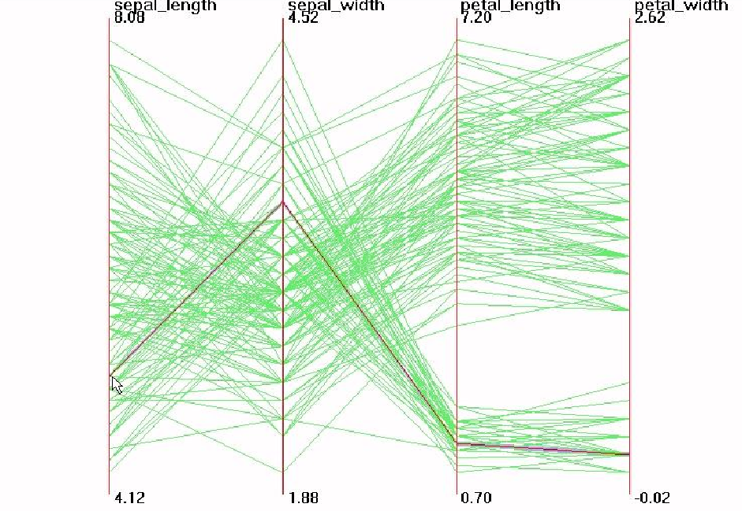
Parallel Visualization of Iris data
3.5
5.1
1.4
0.2
‹#›

Slide 41
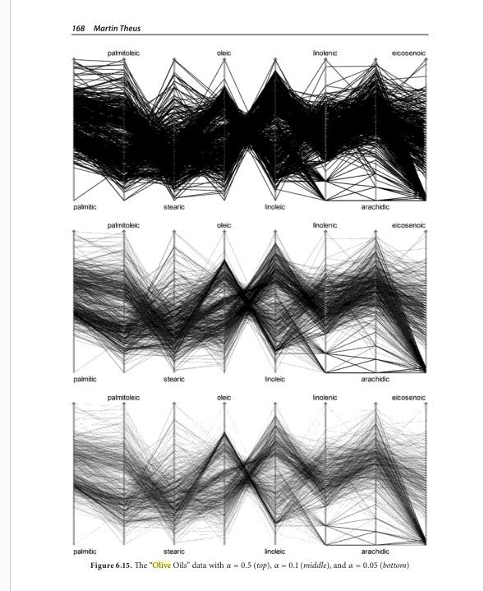
Multivariate: Parallel coordinates
‹#›
Alpha blending can be effective
Courtesy Unwin, Theus, Hofmann

Slide 42
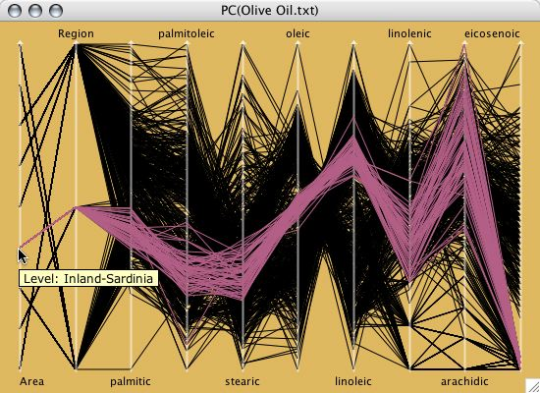
Parallel coordinates
‹#›
Useful in an interactive setting

Slide 43
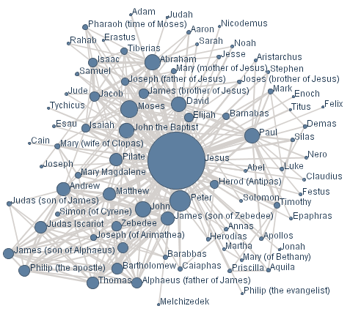
Networks and Graphs
‹#›
Visualizing networks is helpful, even if is not obvious that a network exists

Slide 44
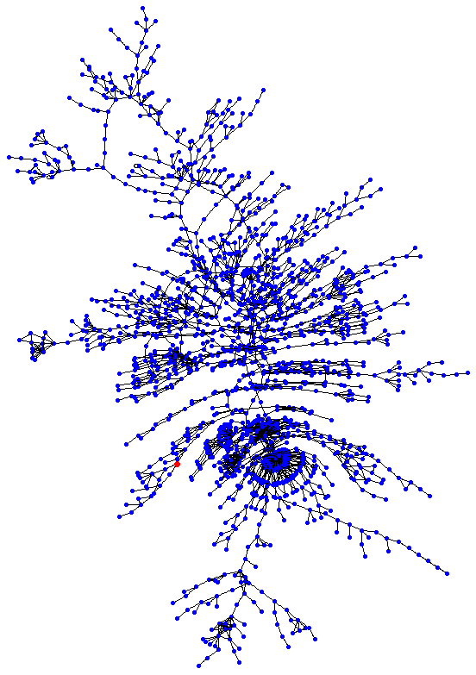
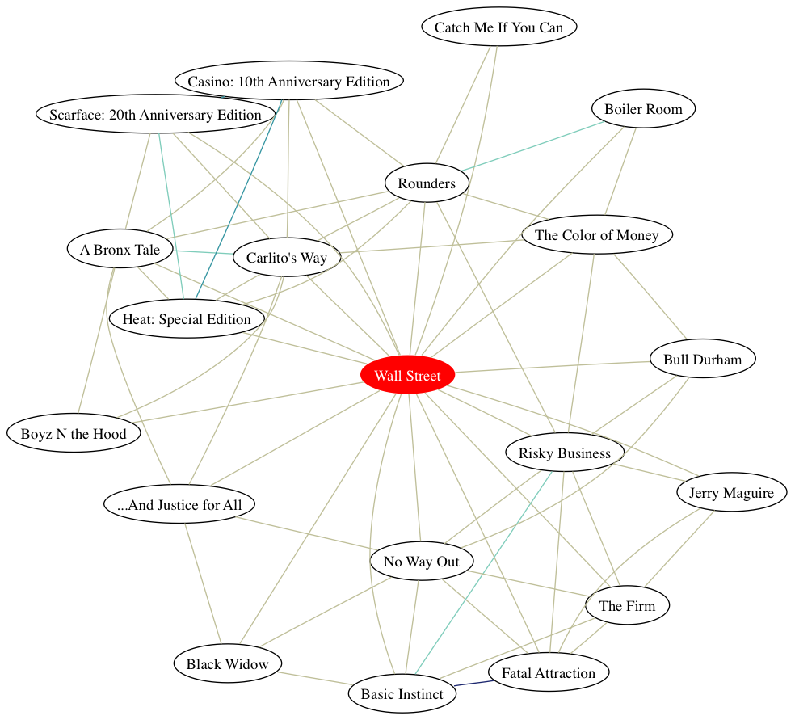
Network Visualization
‹#›
Graphviz (open source software) is a nice layout tool for big and small graphs

Slide 45
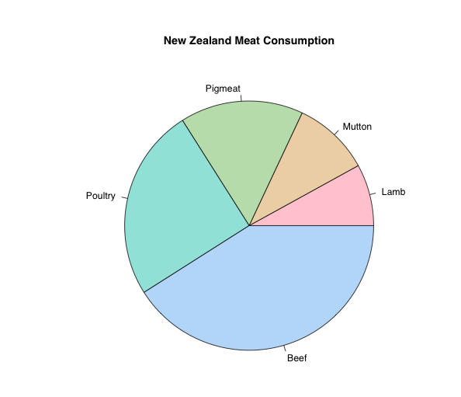
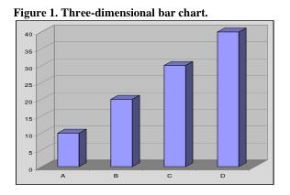
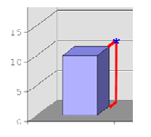
What’s missing?
‹#›
pie charts
very popular
good for showing simple relations of proportions
Human perception not good at comparing arcs
barplots, histograms usually better (but less pretty)
3D
nice to be able to show three dimensions
hard to do well
often done poorly
3d best shown through “spinning” in 2D
uses various types of projecting into 2D
http://www.stat.tamu.edu/~west/bradley/

Slide 46
Dimension Reduction
‹#›
One way to visualize high dimensional data is to reduce it to 2 or 3 dimensions
Variable selection
e.g. stepwise
Principle Components
find linear projection onto p-space with maximal variance
Multi-dimensional scaling
takes a matrix of (dis)similarities and embeds the points in p-dimensional space to retain those similarities
More on this when we talk about Data Visualization

Slide 47
Visualization done right
‹#›
Hans Rosling @ TED
http://www.youtube.com/watch?v=jbkSRLYSojo

